Slide 1
Tony Flett
Rural Financial Counsellor - Deniliquin
0428 815 766

Slide 2
Funded by Federal & State Governments
No charge, free service
Confidential
Impartial
Independent

Slide 3
Help you develop options for your business
Assist you to access programs, loans, support
Help with budgets and cash flows
Meetings with lenders or creditors
Preparation for succession discussions

Slide 4
Broad range of farming businesses
Wide range of issues
Focus on skill building, challenge your thinking, test assumptions
Misconceptions with RFCS

Slide 5
Farm Household Allowance
Approx. $26,000p.a. per couple
$1,500 voucher for Financial Assessment
$3,000 Activity Supplement
$80,000 Off-Farm Income Off-Set

Slide 6
Farm Household Allowance | Restrictions
$5 million of net farm assets, after debt
$387k of off-farm assets.
Farm Management Deposits
Shares
Property
Accommodate sale of assets

Slide 7
Farm Household Allowance
Farm Household Case Officers
Farmer Assistance Hotline 132 316

Slide 8
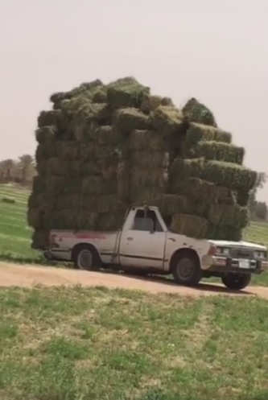
Transport Subsidy
30th September last chance for 2018/19 invoices
Own movements-log books or NVD’s
Fertiliser / Seed / Chemicals now covered
$7.5 max rate increased
50% short trip rate
Maximum distance limit removed

Slide 9
Emergency Water Infrastructure Rebate
25% up to $25,000
Desilting, tanks, pipes, pumps, generators, solar power
Claim back to 1st July 2018
Small time investment

Slide 10
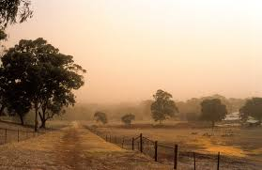
Drought Assistance Fund
$50k interest free, repayment free for 2 years
Double dip 2018 and 2019, to $100k
Eligibility broadened
Fodder/Grain Storage
New/Upgrade Stock Water
Profitability and Resilience
Statutory Charge, Mortgagee Consent

Slide 11
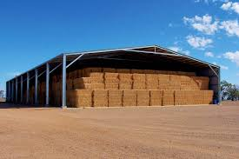
Farm Innovation Fund
2.5% Interest Rate
Up to $1 million per application
Permanent Infrastructure
Monthly Cash Flow Budget 2019/20
Business Plan

Slide 12
Farm Business Skills Program
Risk Management
Financial & Business Management
Business Planning & Drought Preparedness
$5k + additional $4k
50:50
Course fees, travel costs, child care, succession

Slide 13
Farm Business Development Program
Website: Farm Table https://farmtable.com.au/
18-35 year-old
Workshops
Business Coaching
On-line Business School
Social Media connections
Group funding available, up to $10k, 3+ group size

Slide 14
Regional Investment Corporation
3.11%
Loans to $2 million
5 years interest only, 5 years I/P
Refinance 50% commercial debt
Replanting / restocking
Working capital
Pay creditors

Slide 15
RFCS Counsellors
Tony Flett | Deniliquin 0428 815 766
Darren Macartney | Hay 0410 622 599
Airlie Hoskins | Coleambally 0429 396 729
Rural Financial Counselling: https://www.rfcsnsw.com.au
Rural Assistance Authority: https://www.raa.nsw.gov.au
Regional Investment Corporation: https://www.ric.gov.au
Farm Table: https://farmtable.com.au
Drought Hub: https://www.dpi.nsw.gov.au/climate-and-emergencies/droughthub

